Slide 1
Corporate Ownership Classification
NUS Datathon | Category B | Team 66

Slide 2
Project Workflow
Evaluation & Iteration
Problem Definition
Results guide the next iteration of refinements
Understanding objectives and defining labels
Model Training
91%
Accuracy
Tuning model while reducing complexity and overfitting
Data Cleaning
Addressing redundancies, missingness and duplicates
Feature Engineering
Extracting predictive information from raw features

Slide 3
1. Problem Statement

Slide 4
Redefining Problem Statment
Neither DU nor GU: 14589
Is Domestic Ultimate
0
1
1
…
Is Global Ultimate
0
0
1
…
Ultimate Status
0
1
2
…
7086
7507
0
→
+
=
Domestic
Ultimates
Global
Ultimates
Dual Binary Model → Single 3-Class Model
Total Companies: 29182

Slide 5
2. Data Cleaning

Slide 6

Dropping Columns
Uninformative
Redundant
Missing
High Cardinality
LATITUDE
LONGITUDE
Company Status
8-Digit SIC Code
8-Digit SIC Description
Industry
Square Footage
Fiscal Year End
Account ID
Company
Company Description

Slide 7
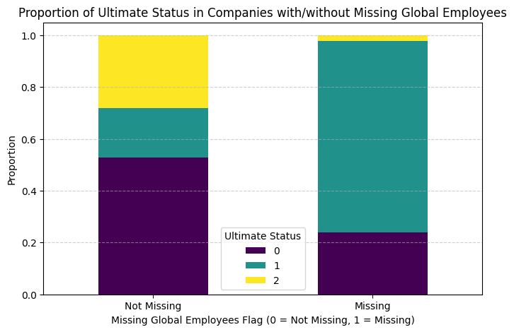
Flagging Missing Data
Employees (Single Site)
10
20
…
NA
NA
…
missing_single_employees
0
0
…
1
1
…
58%
Present
→
43%
Missing

Slide 8
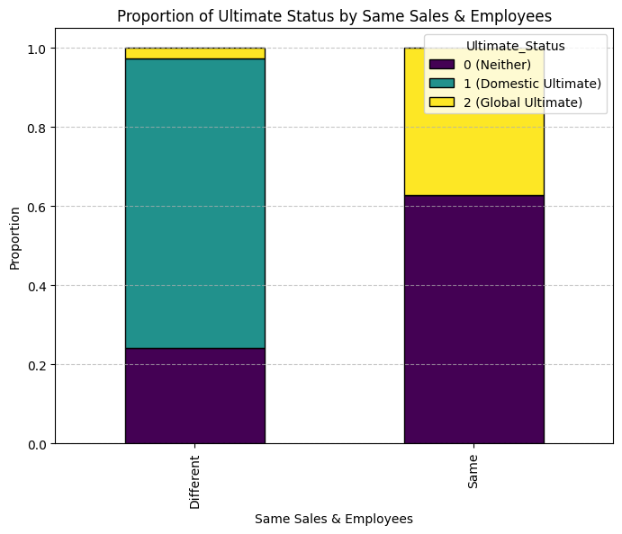
Flagging Partial Duplicates
Employees (Domestic) | Employees (Global) | Sales (Domestic) | Sales (Global)
100 | 100 | $50,000 | $50,000
200 | 200 | $80,000 | $80,000
50 | 50 | $100,000 | $100,000
… | … | … | …
10 | 50 | $28,000 | $34,250
6 | 3 | $15,000 | $50,000
17 | 42 | $200,000 | $27,250
… | … | … | …
67%
Flagging
33%

Slide 9
3. Feature Engineering

Slide 10
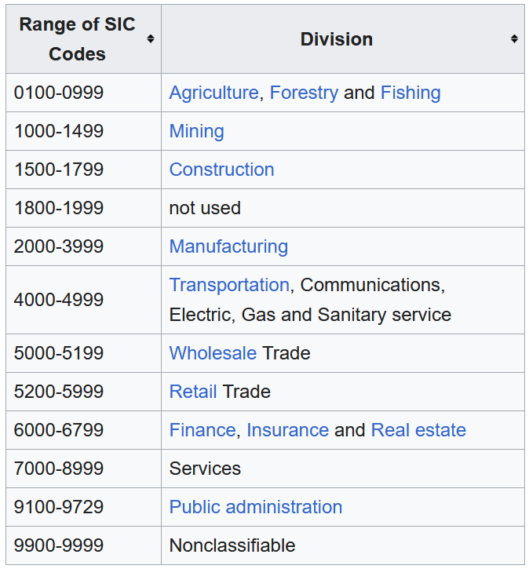
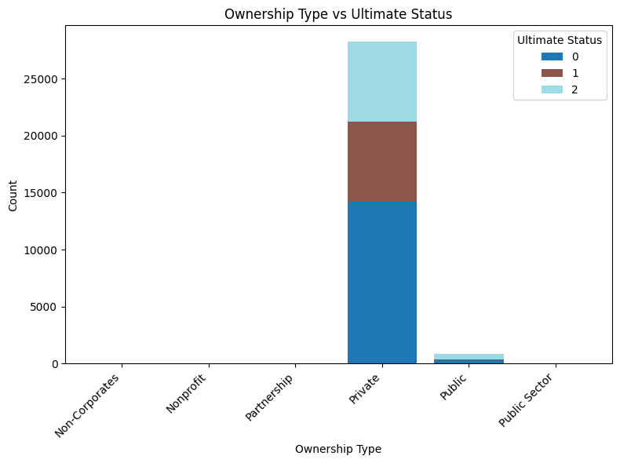
Feature Binning

Slide 11
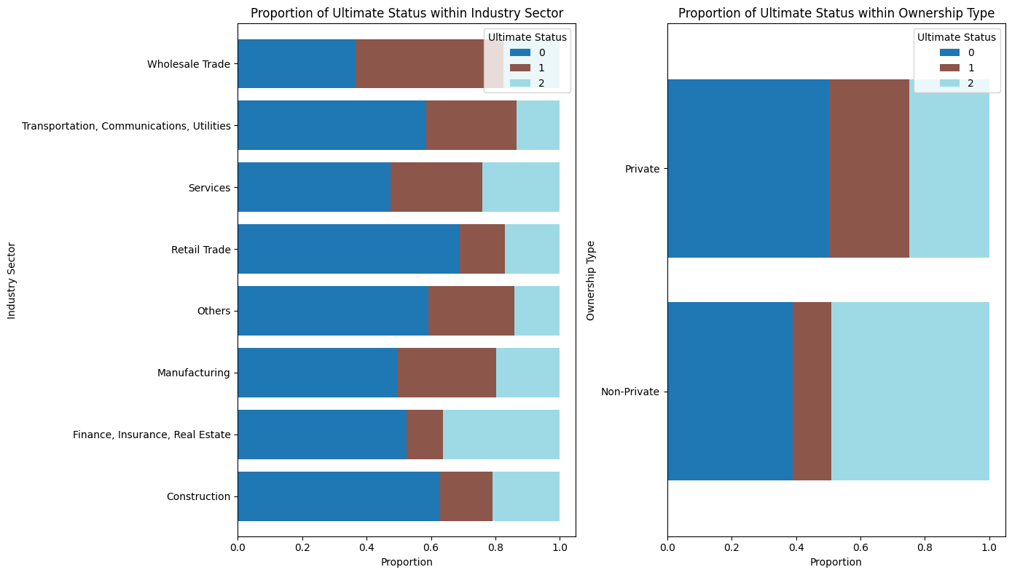
Feature Binning

Slide 12
Variable Interactions
Addition:
Sales (Domestic)
+
Sales (Global)
=
Total Sales
Employees (Domestic)
+
Employees (Global)
=
Total Employees
Ratio:
Sales (Global)
/
Total Sales
=
Global Sales Ratio
Employees (Domestic)
/
Total Employees
=
Domestic Employees Ratio
Employees (Global)
/
Employees (Domestic)
=
Employees Growth

Slide 13
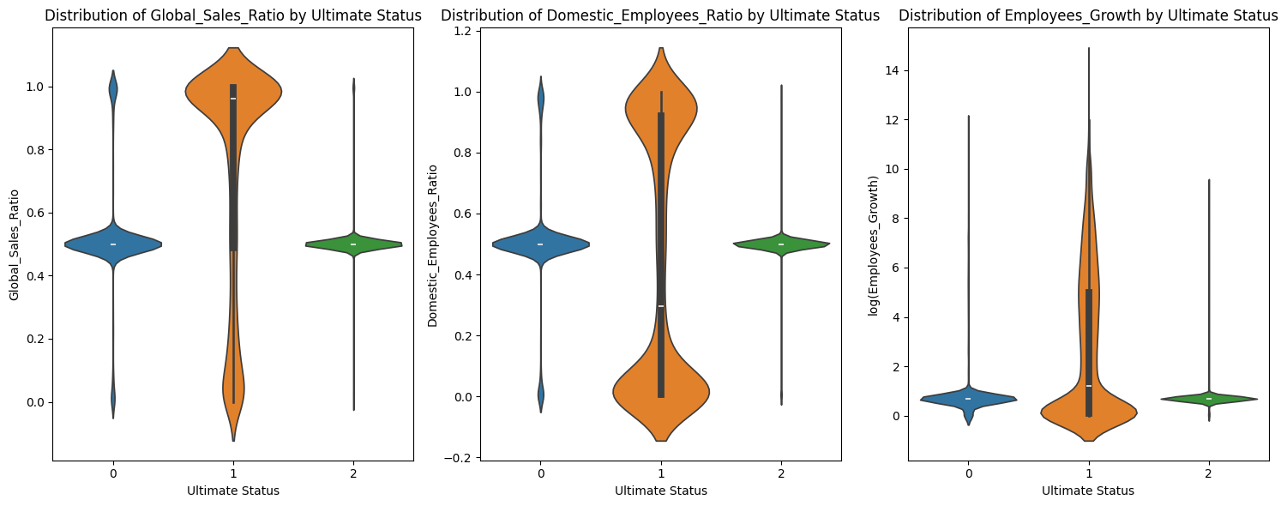
Variable Interactions

Slide 14
4. Model Training
Notes:
Now that we had the right features, we needed to train on the right model.

Slide 15
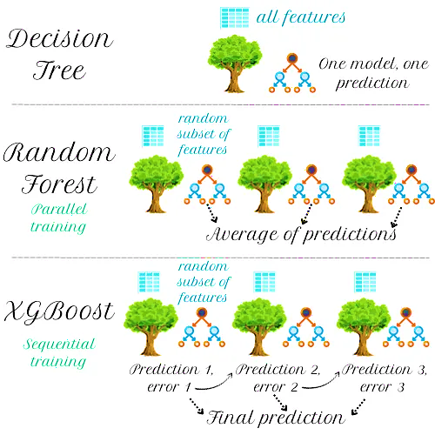
Model Choice
XGBoost
Models | Suitability
Linear Models (Logistic Regression, LDA) | Does not capture non-linear relationships
Distance & Margin Based Models (KNN, SVM) | Slow for large datasets
Neural Networks | Requires massive data
Notes:
We chose XGBoost compared to linear, distance models and neural networks because it captures complex relationships, scales efficiently on large datasets, and is more resistant to overfitting.
XGBoost uses gradient boosting, where trees are built sequentially to correct previous errors, making it more powerful than a basic Random Forest or Decision Tree.
Admittedly, we could have used a simpler model, but due to time constraints, we prioritized speed and efficiency, ensuring low computation time without sacrificing performance.

Slide 16
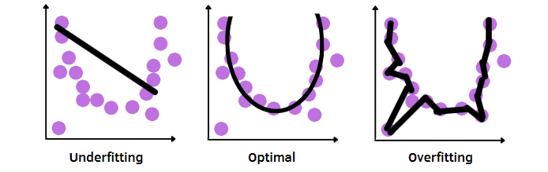
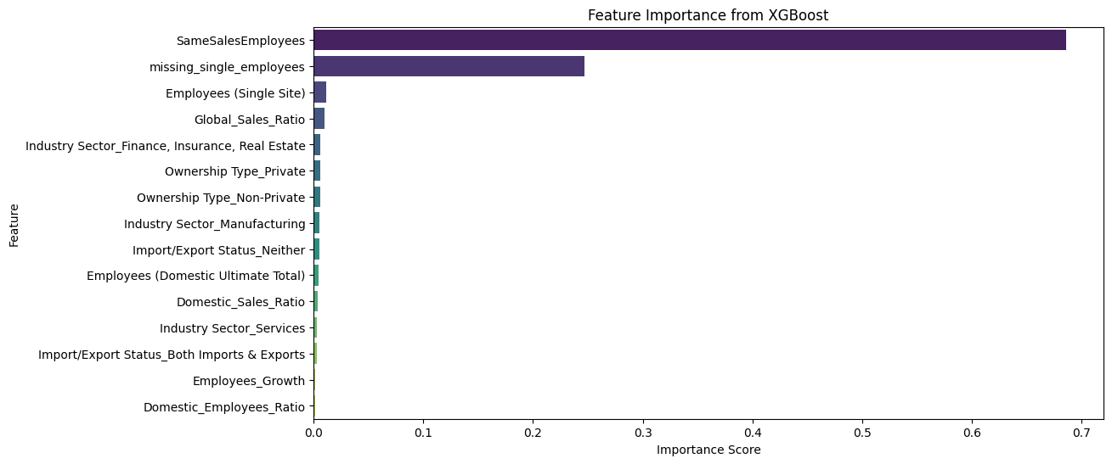
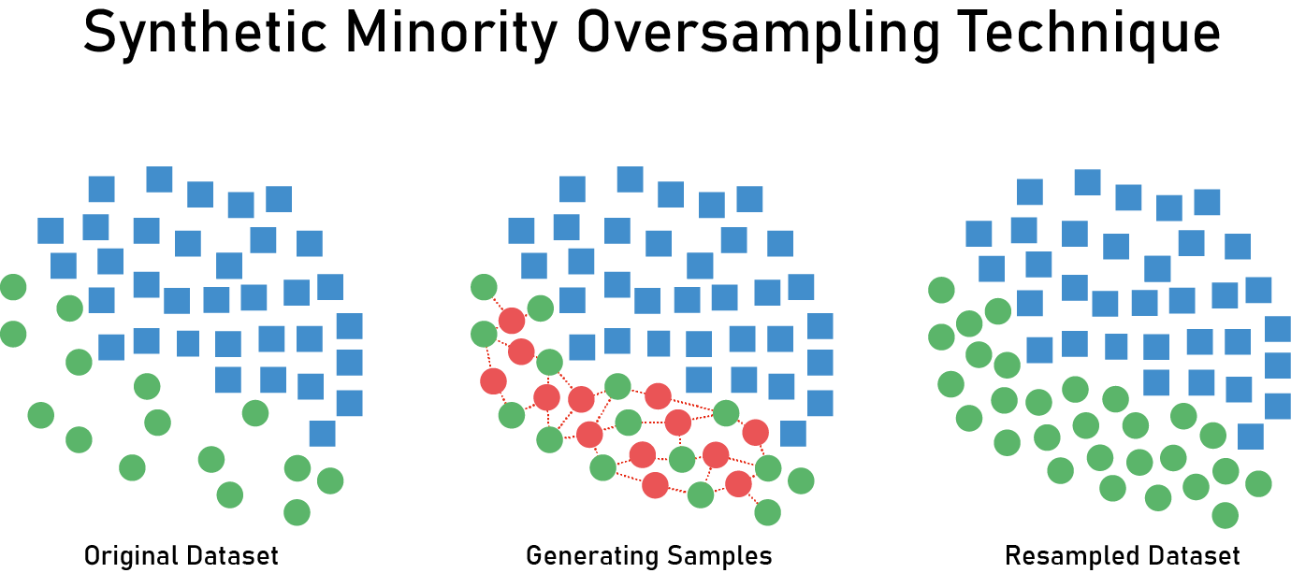
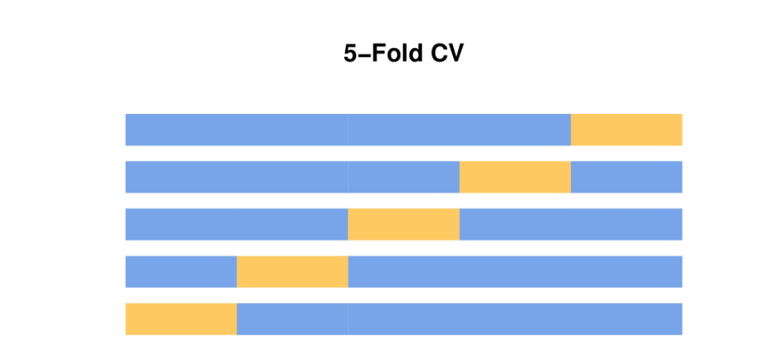
Optimizing Model
L1 Regularization
Model Training
Reducing Complexity
Recursive Feature Elimination
SMOTE
(Synthetic Minority Oversampling Technique)
Prevent Overfitting
5-Fold Cross Validation for Parameter Tuning
Notes:
While optimising our models, we wanted to minimize complexity and overfitting. To reduce complexity,
we used regularization and RFE to determine the optimal number of features.
To prevent overfitting, we applied SMOTE to balance class representation and used 5-Fold CV during hyperparameter tuning to ensure generalization.

Slide 17
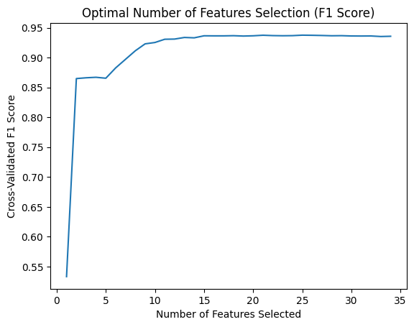
Optimizing Model
Model Training
L1 Regularization
Reducing Complexity
Recursive Feature Elimination
SMOTE
(Synthetic Minority Oversampling Technique)
Prevent Overfitting
 | Validation Set | Test Set
Accuracy | 0.9453 | 0.9145
F1 Score | 0.9353 | 0.9148
5-Fold Cross Validation for Parameter Tuning
Notes:
Looking at our plot, we chose a conservative elbow point of 15 features, cutting our feature space by more than half while maintaining a high F1 score.
This approach worked successful as our validation and test set scores differ by only 2%, proving the model performs well on unseen data while keeping a small feature space.

Slide 18
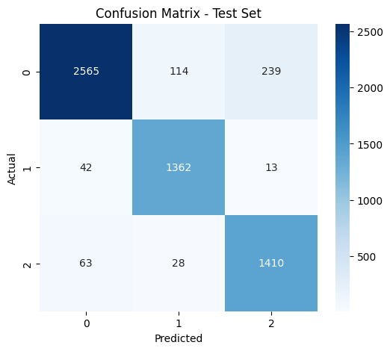
Model Results
Class | Precision | Recall | F1 - Score
0 = Neither | 0.96 | 0.88 | 0.92
1 = Domestic Ultimate | 0.91 | 0.96 | 0.93
2 = Global Ultimate | 0.85 | 0.94 | 0.89
Weighted Average | 0.92 | 0.91 | 0.9148
Accuracy | 0.9145
Notes:
Now, let’s look at our results.
This confusion matrix shows strong performance, with most predictions concentrated along the diagonal, indicating high discriminatory ability.
We evaluated our model using accuracy and F1-score as without domain expertise, we didn’t have a clear cost for misclassification, so we opted for these balanced metrics as a reasonable measure of performance.
With a 91% accuracy and F1-score, our model does a good job at differentiating ownership structures. Let us now look at the potential applications of this model.

Slide 19
5. Applications

Slide 20
Interpreting Model Outputs
Corporate Ownership
Structure
0 = Neither Domestic nor Global Ultimate
1 = Domestic Ultimate but Not Global Ultimate
2 = Both Domestic & Global Ultimate
Likely a subsidiary under corporate control.
Highest entity in the country but still owned by an international parent.
Fully independent in the country OR multinational HQ.
Notes:
Now that we have a model with good classification ability, let's relate its output to the corporate ownership structure. A neither domestic nor global ultimate company is likely a subsidiary, A domestic ultimate but not global ultimate company is the highest entity in the country but still owned by a foreign parent. Lastly, a both domestic and global ultimate company is either fully independent or a multinational headquarters.

Slide 21



Application to Businesses
Corporate Strategy & Competitive Intelligence
Mergers and Acquisitions (MA) & Target Selection
Market Entry & Expansion Strategy
Notes:
This ownership classification helps businesses in three ways:
Firstly, in corporate intelligence, businesses often underestimate the influence of global corporations because subsidiaries appear as separate companies. Hence the model allows us to predict which firms are truly independent players versus subsidiaries of larger corporations which may have global financial backing and supply chain advantages.
In mergers, Investors can quickly assess control structure hence how much bureaucratic or regulatory approval is likely required and avoid wasting time negotiating with subsidiaries with no decision-making powers.
Lastly, for market entry, if analysis reveals a market composition with 70% likelihood of companies being owned by some parent company. It suggests that the market may be dominated by hidden global players. Hence the business may also prioritize partnership with local players or prepare for competition with multinational firms.

Slide 22
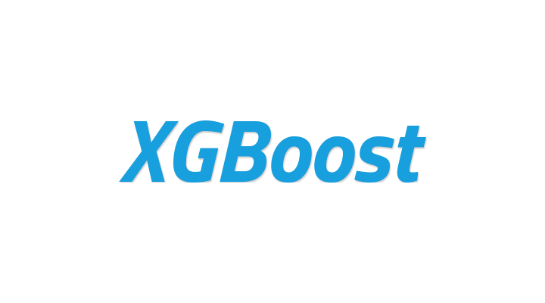


Business Value
Aspects | Benefits
Feasibility | XGBoost is a pre-existing industry standard ML Data is already collected
Scalability | XGBoost can process millions of records Pre-trained models can be integrated into cloud platforms
Cost Savings | Automated classification is cheaper and faster Finnancial benefits that come with accurate classifications
Notes:
In terms of practicality, XGBoost is industry-standard and widely used in enterprise machine learning applications and relies on corporate financial and structural data, which organizations already collect for regulatory and operational reasons. It can process millions of records efficiently due to its tree-based approach and parallel processing. Pre-trained models can be integrated into cloud platforms like Microsoft Azure and AWS Sagemaker which then can be deployed as an API and integrated into corporate data pipelines.
Lastly, automating ownership classification is significantly faster and can reduce manual compliance costs for financial institutions and corporations.
In conclusion, this combined with the strategic benefit mentioned earlier, reduces financial risk, which may lead to better investment and success for the company. Thank you for your time and we are now open to questions.

Slide 23
Thanks!
Team B66
Bryan Kee Tze Ren
Soh Kai Le
Li Qi Ying
Nevin Allen Marian
Chan Wei Wen Kevin

